Slide 1
UML

Slide 2
UML
What is UML
History of UML
Importance of software model
Various diagram of UML
Use of UML Diagram

Slide 3
What is UML
Unified modeling language (UML) for visualizing, specifying, constructing, documenting of artifact of a software system
The blueprint of a system is written in it
UML is also used for modeling non-software system
It is standard for building object oriented and component based software system
UML is a notation system though which we can visualize a model of a system
It describe only design or structure of system

Slide 4
History of UML
In early stages of model driven development there was a great need for some universal approach for modeling a software system
As deferent people understand the notation in different way if there is no universal model approach
At that time brooch, rumba, Jacobson gave there theories and universally accepted
All of three decided to build a notation language by merging all of three language and out product of that was UML (unified modeling language )

Slide 5
History of UML
In 1997 OMG (Object management group) a non profit organization standardized the UML
Since then they are making improvement in UML
Released versions of UML

Slide 6
Versions of UML
2.2 February 2009 http://www.omg.org/spec/UML/2.2
2.1.2 November 2007 http://www.omg.org/spec/UML/2.1.2
2.1.1 August 2007 http://www.omg.org/spec/UML/2.1.1
2.0 July 2005 http://www.omg.org/spec/UML/2.0
1.5 March 2003 http://www.omg.org/spec/UML/1.5
1.4.2 July 2004 ISO/IEC 19501
1.4 September 2001 http://www.omg.org/spec/UML/1.4
1.3 March 2000 http://www.omg.org/spec/UML/1.3
1.2 July 1998
1.1 November 1997

Slide 7
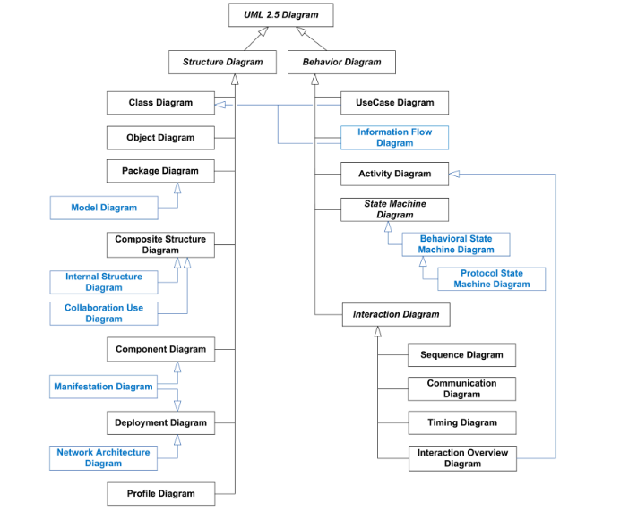

Slide 8
Structural Modeling Diagram
Class Diagram
Object Diagram
Component Diagram
Package Diagram
Composite Structure
Deployment Diagram

Slide 9
Behavioral Modeling Diagram
Use Case Diagram
Activity Diagram
State Machine Diagram
Communication Diagram
Sequence Diagram
Timing Diagram
Interaction Over view Diagram

Slide 10
Interaction Diagrams Modeling Diagram
Communication Diagram
Sequence Diagram
Timing Diagram
Interaction Over view Diagram

Slide 11
Important diagram
Use Case Diagrams
Class Diagrams
Object Diagrams
Sequence Diagrams
Communication Diagrams
Deployment Diagrams
Component Diagrams

Slide 12
Use Case Diagram
A USE CASE is an interaction between a system and external stimulate, that could a human and may be an external system
A USE CASE diagram is an purposed functionality of the system
USE CASE diagram is used to show a discrete unit of work
It is used at early stages of model
It is the simplest diagram
Example of USE CASE for a Stock trading system
Open an account
Close an account
Deposit funds
Draw funds

Slide 13
Use Case diagram
This diagram consist of:
Actor
It is represented by a human, either the actor is a human
Or and external system.
Actor is role
Use case
It is represented by an oval shape with title in it

Slide 14
Use Case diagram
USE CASE diagram have relationship
Include
It is relationship between a use case to another use case
In which a include use case in necessary to perform other use case, for example in place order use case every time the check funds use case is included to complete the place order use case
place order(use case) <include > (check funds) use case

Slide 15
Use Case diagram
USE CASE diagram have relationship
Extends
It is relationship between a use case to another use case
In which a extends use case in exceptionally called for example, if before modifying a particular type of customer order, a user must get approval from some higher authority then the <Get Approval> use case may optionally extend the regular <Modify Order> use case.
Modify order(use case) <extends> (Get Approved) use case

Slide 16
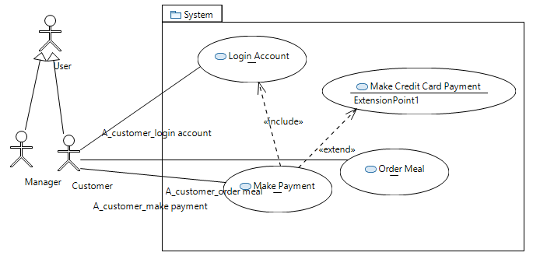
Use case diagram

Slide 17
Class diagram
It depicts the static view of a model
It is the basic building block of the object oriented system
It illustrate the relation ship between classes in the system
Class diagram consist of:
Class diagram
It consist of rectangle with three compartments
Class name is added in this this compartment (teacher)
Class attribute is added in this department (name )
Class methods are placed in this compartments (teach)

Slide 18
Class diagram
+ sign with attributes or methods shows class member are public
- sign with attribute or methods shows class members are
private
Class name is added in this this compartment (teacher)
Class attribute is added in this department (-name)
Class methods are placed in this compartments (+teach)

Slide 19
Class Diagram
Each class is represented by a rectangle subdivided into three compartments
Name
Attributes
Operations
Modifiers are used to indicate visibility of attributes and operations.
‘+’ is used to denote Public visibility (everyone)
‘#’ is used to denote Protected visibility (friends and derived)
‘-’ is used to denote Private visibility (no one)
‘~’ is to denote default or package visibility
By default, attributes are hidden and operations are visible.
The last two compartments may be omitted to simplify the class diagrams

Slide 20
Notation of Class Diagram: association
Associations represent relationships between instances
of classes .
An association is a link connecting two classes.
Bi-directional association Associations are assumed to be bi-directional
e.g. Flight and plane
notation:
Uni-directional association e.g. Order and item
notation:

Slide 21
Association: Multiplicity and Roles
student
1
*
University
Person
0..1
*
employer
teacher
Multiplicity
Symbol Meaning
1 One and only one
0..1 Zero or one
M..N From M to N (natural language)
* From zero to any positive integer
0..* From zero to any positive integer
1..* From one to any positive integer
Role
Role
“A given university groups many people; some act as students, others as teachers. A given student belongs to a single university; a given teacher may or may not be working for the university at a particular time.”

Slide 22
Notation of Class Diagram: Generalization
Supertype
Example:
Customer
Regular
Customer
Loyalty
Customer
Subtype1
Subtype2
or:
Customer
Generalization expresses a relationship among related classes. It is a class that includes its subclasses.
Regular
Customer
Loyalty
Customer

Slide 23
Notation of Class Diagram: Aggregation
Container Class
Aggregation: expresses a relationship among instances
of related classes. It is a specific kind of Container-Containee relationship.
It expresses a relationship where an instance of the Container-class has the responsibility to hold and maintain instances of each Containee-class that have been created outside the auspices of the Container-class. Aggregation should be used to express a more informal relationship than composition expresses.
That is, it is an appropriate relationship where the Container and its Containees can be manipulated independently.
Aggregation is appropriate when Container and Containees have no special access privileges to each other.
Class C
AGGREGATION
Class E₁
Class E₂
Containee Classes
Example
Bag
Apples
Milk

Slide 24
Notation of Class Diagram: Composition
COMPOSITION
Composition: expresses a relationship among instances
of related classes. It is a specific kind of Whole-Part relationship.
It expresses a relationship where an instance of the Whole-class has the responsibility to create and initialize instances of each Part-class. It may also be used to express a relationship where instances of the Part-classes have privileged access or visibility to certain attributes and/or behaviors defined by the Whole-class. Composition should also be used to express relationship where instances of the Whole-class have exclusive access to and control of instances of the Part-classes.
Composition should be used to express a relationship where the behavior of Part instances is undefined without being related to an instance of the Whole. And, conversely, the
behavior of the Whole is ill-defined or incomplete if one or more of the Part instances are undefined.
Whole Class
Class W
Class P₁
Class P₂
Part Classes
Example
Automobile
Engine
Transmission

Slide 25
Aggregation vs. Composition
Composition is really a strong form of aggregation
components have only one owner
components cannot exist independent of their owner;
both have coincident lifetimes
components live or die with their owner
e.g. (1)Each car has an engine that can not be shared
with other cars.
(2) If the polygon is destroyed, so are the points.
Aggregations may form "part of" the aggregate, but may not be essential to it. They may also exist independent of the aggregate. Less rigorous than a composition.
e.g. (1)Apples may exist independent of the bag.
(2)An order is made up of several products, but the
products are still there even if an order is
cancelled.

Slide 26
Object diagram
An object diagram may be considered a special case of a class diagram
Object diagrams emphasize the relationship between instances of classes at some point in time
Object is shown by a rectangular with classifier name in the center of rectangular and under line
Object diagram shows complex relationship between classes
It is useful if we feel classes as more abstract abstract

Slide 27
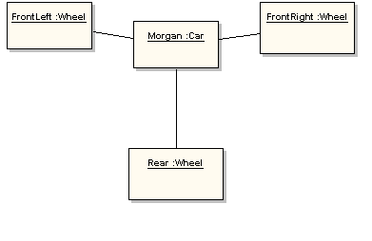
Object diagram

Slide 28
Package diagram
Package diagram are used to divide the model into logical containers and their interaction
Package diagram is used to show the high level view of the system
As software system have a lot of class (building block in object oriented system) to organize those in a package to show higher level view of the system
Package is used to structure your classes
Package diagram is used divide the complex system in to modules
And In large system to show the large elements and their communication
It is used in large and complex systems

Slide 29
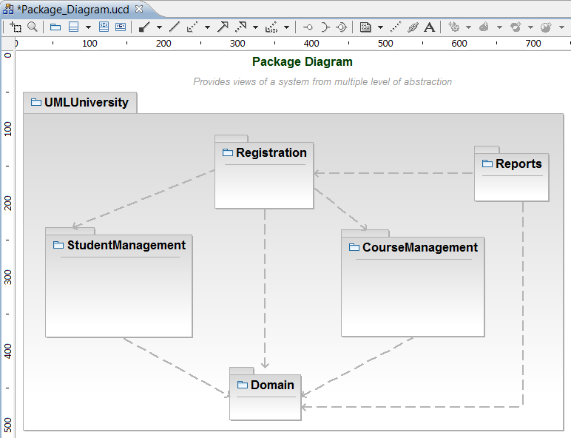
Package diagram (merge)

Slide 30
Package diagram
A «merge» connector between two packages defines an implicit generalization between elements in the source package

Slide 31
Interaction diagram
Interaction diagram are models that describe how groups of objects collaborates in some behaviour
An interaction diagram captures the behaviour of a single use case.
There are two kinds of Interaction diagram
Sequence diagram
Collaboration diagram (Communication diagram)

Slide 32
Sequence diagram
Sequence diagrams can be useful reference diagrams for businesses and other organizations.
Represent the details of a UML use case.
Model the logic of a sophisticated procedure, function, or operation.
See how tasks are moved between objects or components of a process.
Plan and understand the detailed functionality of an existing or future scenario.

Slide 33
Sequence diagram component
Object - this box shape represents a class, or object, in UML. They demonstrate how an object will behave in the context of the system. Class attributes should not be listed in this shape.
Activation boxes - symbolized by a rectangle shape, an activation box represents the time needed for an object to complete a task. The longer the task will take, the longer the activation box becomes.
Lifeline - a dashed vertical line that represents the passage of time as it extends downward. Along with time, they represent the sequential events that occur to an object during the charted process. Lifelines may begin with a labeled rectangle shape or an actor symbol.

Slide 34
Continue...
Messages - packets of information that are transmitted between objects. They may reflect the start and execution of an operation, or the sending and reception of a signal.
Synchronous messages - represented by a solid line with a solid arrowhead. This symbol is used when a sender must wait for a response to a message before it continues. The diagram should show both the call and the reply.
Asynchronous messages - represented by a solid line with a lined arrowhead. Asynchronous messages are those that don't require a response before the sender continues. Only the call should be included in the diagram.

Slide 35
Continue...
Create messages - represented by a dashed line with a lined arrowhead. These messages are sent to lifelines in order to create themselves.
Reply messages - represented by a dashed line with a lined arrowhead, these messages are replies to calls.
Delete messages - represented by a solid line with a solid arrowhead, followed by an X symbol. This messages indicates the destruction of an object and is placed in its path on the lifeline.

Slide 36
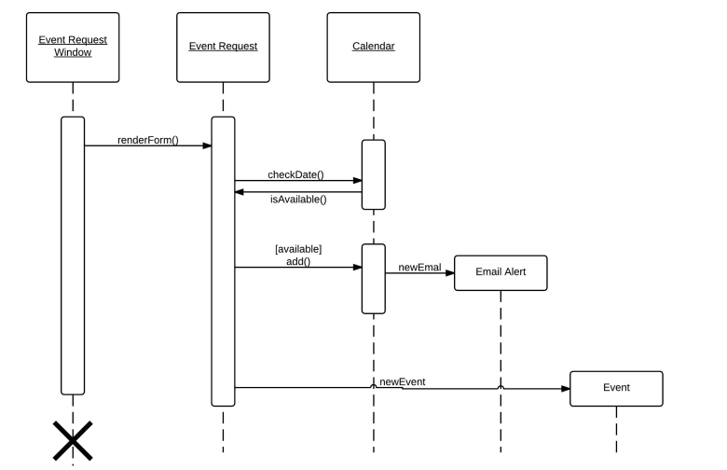

Slide 37
Communication diagram
A communication diagram visually represents the message flow between objects in an application.
The notation here uses the same notation as the sequence diagram.

Slide 38
Symbol and notations
The rectangles represent objects that are needed to make up the application.
The lines between class instances represent the relationships between different parts of the application.
The arrows represent the messages that are sent between objects.
The numbering lets you know in what order the messages are being sent and how many messages are need to finish a process.

Slide 39
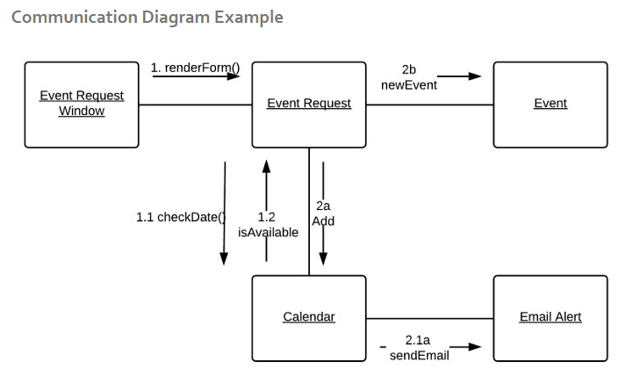

Slide 40
Component diagram
Component diagram shows the system in term modules
Components can be represented as encapsulated, reusable, replaceable
Component can be used as building block of the system
Component communicate with each other through interfaces
Component can do the same thing as class

Slide 41
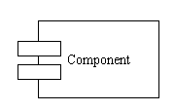
Continue…
Symbols and Notations
Components
a large rectangle with two smaller rectangles on the side.

Slide 42
Component Diagram (cont.)
order
customer
account
Order provides a component interface, which is a collection of one or more methods with or without attributes.
Account and customer components are dependent upon the interface of the order.

Slide 43
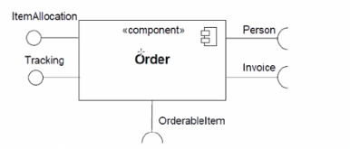
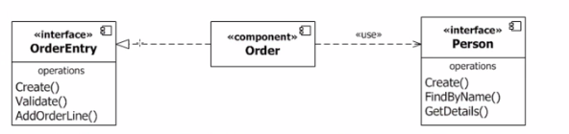

Slide 44
Deployment diagram
Deployment diagram model the physical layout of the system mapping software artifact to hardware in which they execute and their communication
Deployment diagram is used to show the physical deployment of the system
Deployment diagram has node which may be a hard ware or any device that host the software and my be a software that host another software (example operating system)
Artifacts shows the software that is implemented on the hardware
It show the physical relationship between a system, software and hardware

Slide 45
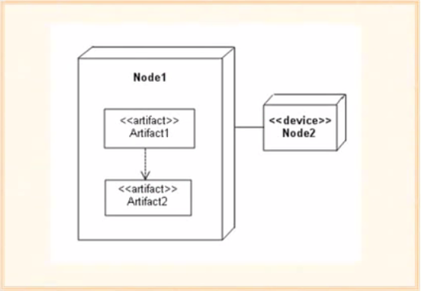

Slide 46
Note
In the world of the deployment diagram, system refers to the software you deploy and the software and hardware that enables your deployed software to run.
Use
To create a rough sketch of the physical layout of your system early in the deployment life cycle.
To identify and explore the dependencies between this system and other systems in its environment

Slide 47
Nodes
Node - A hardware or software object, shown by a three-dimensional box.
Types of Nodes
Device Node : computing resources that have processing capabilities and the ability to execute programs. Ex : PC, Laptop, Mobile phone
Execution environment node: An EEN is any computer system that resides within a device node. Ex: OS, JVM or Container (Web Container or EBJ Container)

Slide 48
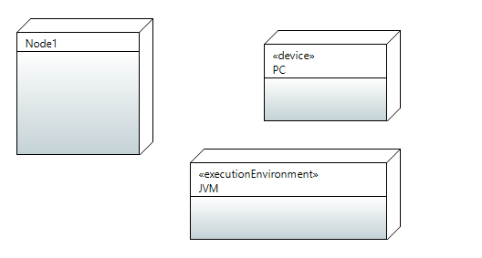

Slide 49
Artifact
Artifact - a product developed by the software, symbolized by a rectangle with the name and the word “artifact” enclosed by double arrows.
It is a physical file such as the executable library or soure file, jar, war, ear etc.

Slide 50
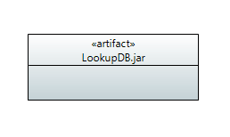

Slide 51
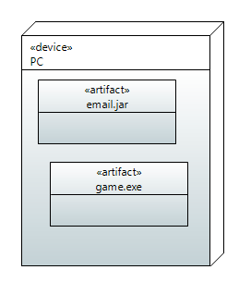

Slide 52
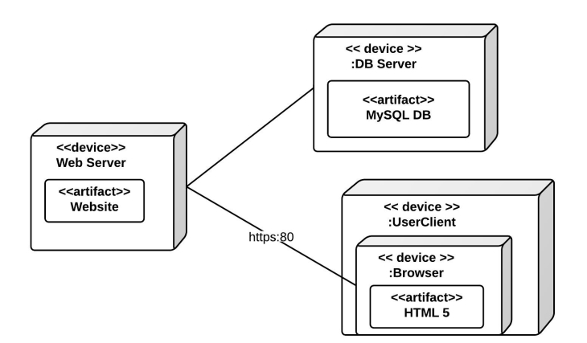
Deployment diagram

Slide 53
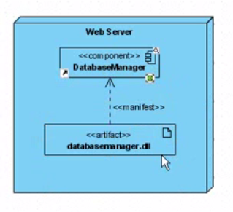
Deployment with Component

Slide 54
Thank You!

